Slide 2
Why do we learn about fundamental British Values?
Fundamental British Values are what help us to be citizens in a modern Britain, celebrating the diversity of the country in which we live
These values are Democracy, Rule of Law, Respect and Tolerance, Individual Liberty.

Slide 3
Explore the rights we have of freedom of speech; to express our personal beliefs
Explore how to express ourselves considering the other British Values

Slide 4
Explore different types of government, political ideologies and voting systems.
Understand how citizens can influence decision making through the democratic process.

Slide 5
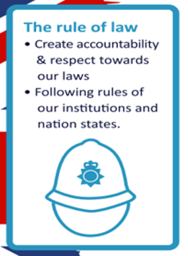
Consider how living under the rule of law protects and promotes the well-being a safety of citizens.
Examine link between rights and responsibilities and explore how Human Rights protect individuals, promote standards in living and equality between groups.

Slide 6
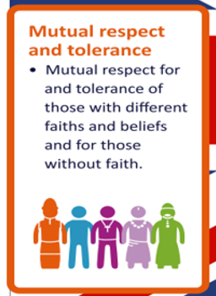
To examine the variety and growth of religion in the UK
To understand that the freedom to choose and hold these faiths is protected in law.

