Slide 1
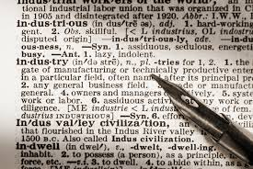
This week’s career of the week is…..
Lexicographer

Slide 2
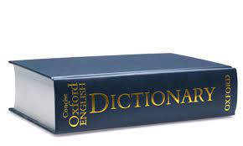
What is it??
Lexicographers write and compile dictionaries for online use and for publication.

Slide 3
Where could I work?
Employers are:
Oxford University Press
Collins
Pearson
Opportunities for Lexicographers occur in towns and cities where these employers are based.
Self-employment:
Experienced people could work independently as self-employed, freelance Lexicographers.

Slide 4
How Much Could I Earn?
Starting: £22,500 - £24,500
With experience: £25,500 - £27,500
Senior Lexicographers earn £29,000 - £31,000

Slide 5
What qualifications would I need?
Generally, you need a degree to become a Lexicographer. Some entrants have a degree in a relevant subject such as English language and linguistics.
For entry to a degree course, the usual requirement is:
2/3 A levels
GCSEs at grade 4 or above in 2/3 other subjects
Alternatives to A levels include:
BTEC level 3 qualifications
the International Baccalaureate Diploma

Slide 6
Other routes into the Career
There are courses in lexicography and lexical computing. By the end of the course, you would have learnt:
introduction to lexicography and lexical computing
translation and bilingual issues
how to write and evaluate definitions
effects of digital dictionary policies
how to use key word extraction
These courses could give you that great first step into Lexicography.
A great way to get into this career is through an internship. An internship is a period of work experience, offered by an organisation, lasting for a fixed period of time anywhere between a week and 12 months. They are typically undertaken by students and graduates looking to gain relevant skills.

Slide 7
Skills and Qualities
To become a Lexicographer, you will need to be:
confident and enthusiastic
able to understand ideas and express them clearly in writing
able to keep up to date with new media
prepared to accept criticism and the frustration of having your work changed
able to work under pressure to meet deadlines
good at English grammar, punctuation and spelling
good with IT
researching new entries and ideas

Slide 8
So what do lexicographers do?
https://www.google.com/search?q=lexicographer&safe=active&rlz=1C1CHBF_en-GBGB932GB936&hl=en-US&source=lnms&tbm=vid&sa=X&ved=2ahUKEwiP9K2A0dH8AhWNN8AKHYiuA-EQ_AUoBHoECAEQBg&biw=1536&bih=722&dpr=1.25&surl=1#fpstate=ive&vld=cid:294d8174,vid:2BqihoU_wqE

