Slide 1
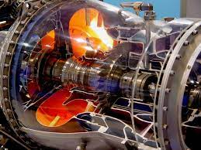
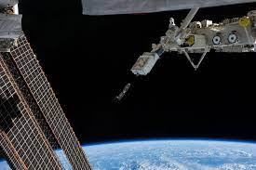
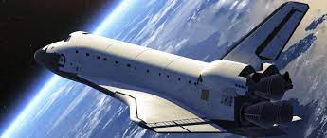
This week’s career of the week is…..
Aerospace engineer

Slide 2
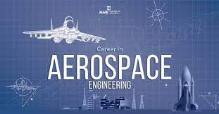
What is it??
Sometimes also called aeronautical engineer.
Aerospace engineers design, build and maintain planes, spacecraft and satellites.
You could be involved in the following tasks:
develop navigation, communications or weapons systems
research ways to make fuel-efficient parts, such as wings, fuselage and engines
use CAD (Computer Aided Design) software for design
test prototypes
collect and analyse test data
plan and supervise the fitting of aircraft and components
supervise maintenance
With experience, you could specialise in a particular field like:
aerodynamics
fuel efficiency
space technology
investigating air accidents

Slide 3
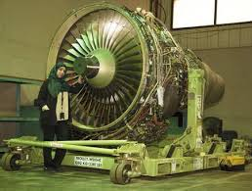
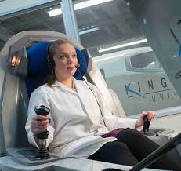
Where could I work?
You could end up working in a factory, office, aircraft hangar or even on an aircraft.
You could work for BAE systems in Porton Down
Taunton Aerospace in Verwood, near Ringwood
Chordline Engineering in Swindon
Aerotek Aviation Engineering in Poole
Whiteley Aerospace Safety Engineering & Management in Swindon
Middlesex Aerospace in Basingstoke
Aerospace Engineering at the University of Bristol
TAG Farnborough Engineering at Farnborough Engineering in Hampshire
And of course at QinetiQ at Boscombe Down near Salisbury
To name just a few places locally which have jobs as an aerospace engineer.

Slide 4
How Much Could I Earn?
Typical salary starts at £25, 000
This can increase to £52, 000 per year for more experienced workers.
Usually you would be working between 37 and 40 hours per week, mostly on a weekday.

Slide 5
What qualifications would I need?
You could go to university and do a foundation degree, higher national diploma or degree in aerospace engineering, avionics, or a related subject like:
electrical or electronic engineering
mechanical engineering
manufacturing or product engineering
physics or applied physics
software engineering or mathematics
You'll usually need:
1 or 2 A levels, or equivalent, for a foundation degree or higher national diploma
2 or 3 A levels, or equivalent, including maths, for a degree in aerospace engineering or related degree

Slide 6
Or you could study at college
You can do a higher national certificate (HNC) or diploma (HND) in engineering before applying for a job with an aerospace company. Subjects include:
Level 4 Diploma in Mechanical Engineering
Level 5 Diploma in Aeronautical Engineering
Level 5 Diploma in Electrical Engineering
Entry requirements
You may need:
1 or 2 A levels or a level 3 diploma already studied at college

Slide 7
Or you could do an apprenticeship and earn while you learn
You could do an engineering higher or degree apprenticeship. Relevant apprenticeships for working in the aerospace industry include:
aerospace engineer
electro-mechanical engineer
materials science technologist
You would combine learning in the workplace with studying for a degree at an approved university.
You'll usually need:
4 or 5 GCSEs at grades 9 to 4 and A levels, or equivalent

Slide 8
Or
You may be able to join a company as an engineering technician and do training on the job to qualify as an engineer.

Slide 9
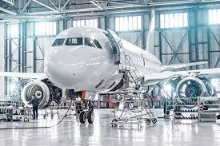
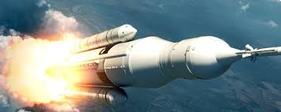
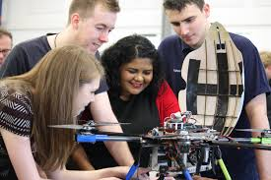
So what do aerospace engineers do?
https://www.youtube.com/watch?v=M6PTJptKZhI

